Slide 1


TSA: Forecasting of Store Sales
Presented By: Selva Rama Bala Subramanian S
Mentors:
Ms. Komilla Bhatia
Ms. Nisha Jenipher

Slide 2
Agenda
1) Introduction
2) Business Scenario
3) Forecast of Sales
4) Algorithms
5) Summary
Presentation Title

Slide 3


Business Objective
FORECAST the sales of a store

Slide 4
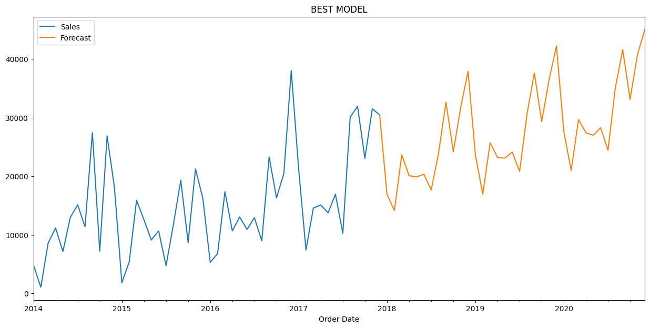

Forecast of Office supplies Sales:

Slide 5
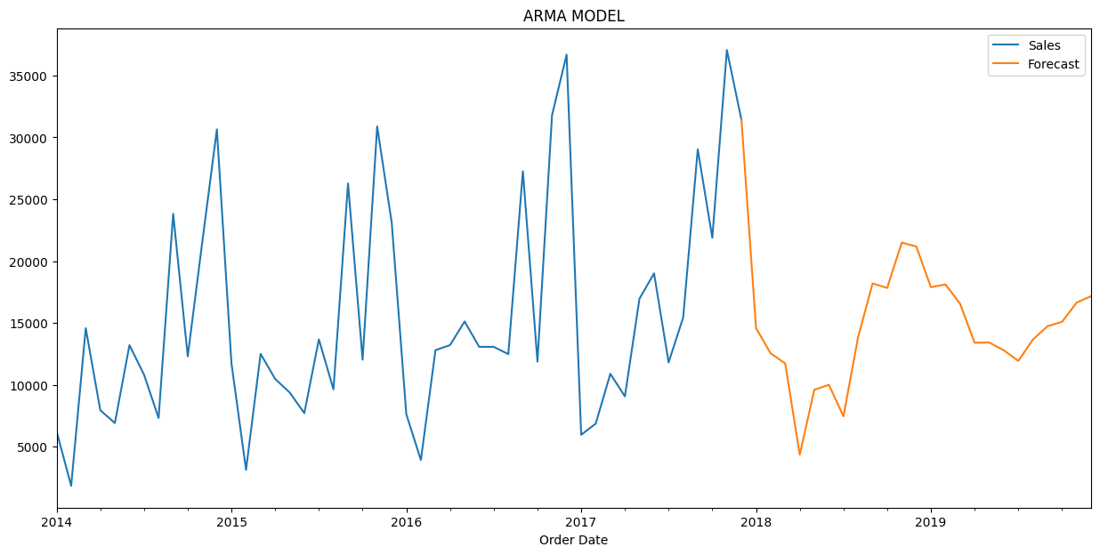
Forecast of Furniture Category

Slide 6
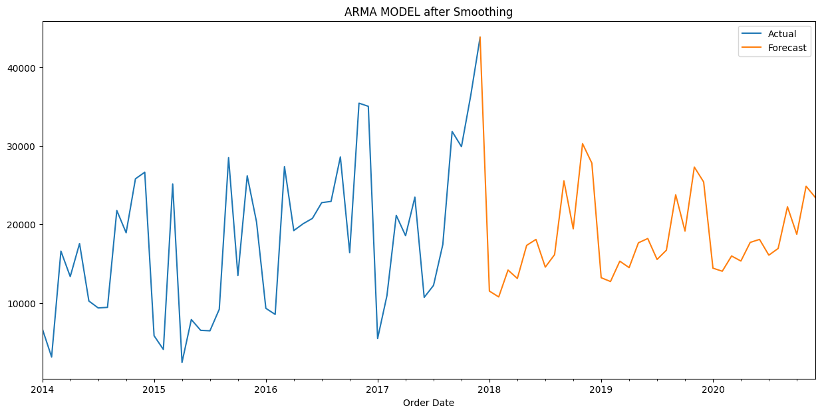
Forecast of Furniture Category

Slide 7
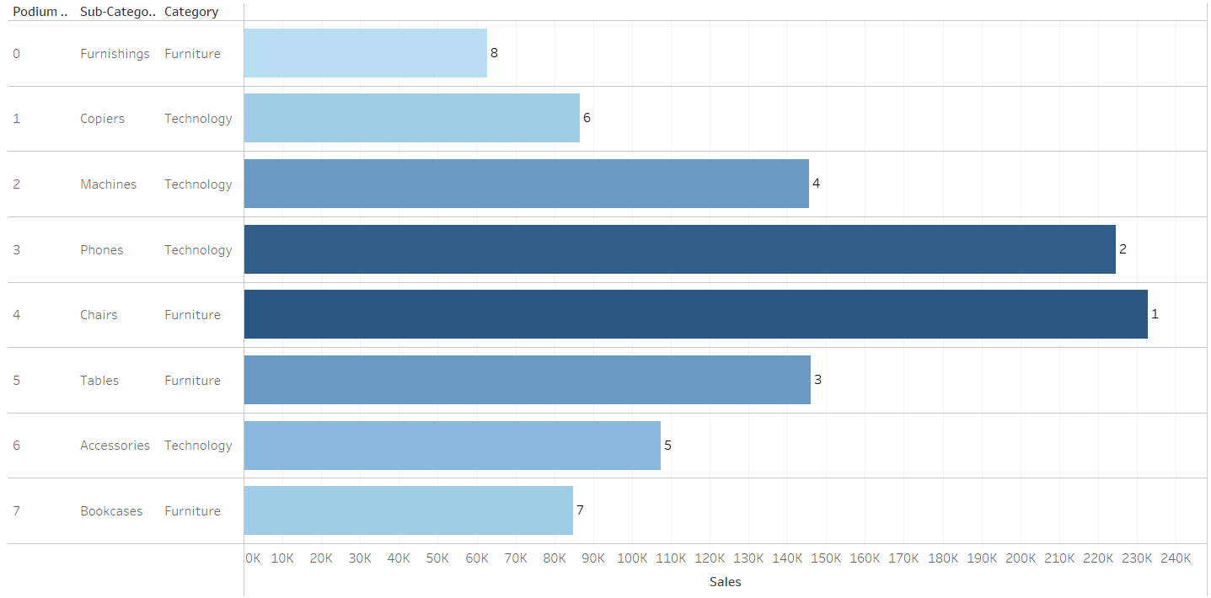
RANKING OF PRODUCT WISE SALES OF FURNITURE AND TECHNOLOGY CATEGORY

Slide 8
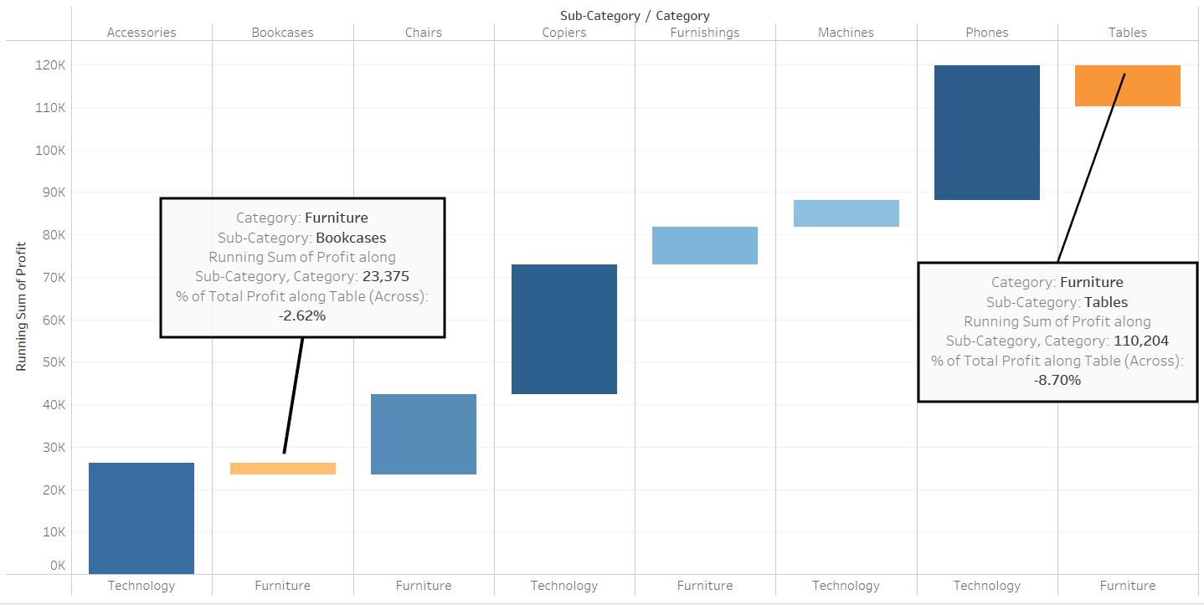
LOSS MAKING PRODUCTS OF FURNITURE AND TECHNOLOGY CATEGORY

Slide 9





Model selection and Evaluation:
Choose the model
Ljung Box Test
Forecast the model
Find the accuracy of the model
Best Model
ARMA
ARMA with Exponential Smoothing
ARIMA
SARIMA
Prove whether the model is good or bad using Ljung Box Test.
Forecast the model and Plot the actual and forecasted values.
Calculate the MSE and RMSE Score of the each model for the comparison.
Choose the best model with least RMSE Score.

Slide 10
FORECAST OF OFFICE SUPPLIES:
Stationarity Check
p-value > 0.05, It is not Stationary data
ARIMA and SARIMA Models
Hyper Parameters Tuning of Models
For ARIMA best model is p = 1, d = 1, q = 1
For SARIMA best model is P = 2, D = 1, Q = 2, m = 12
Forecast
Best Model is SARIMA, plotted actual and forecasted sales
There is increasing of sales in upcoming years for office supplies

Slide 11
FORECAST OF FURNITURES:
Stationarity Check
p-value < 0.05, It is a Stationary data
ARMA and ARMA with Exponential Smoothing Models
Hyper Parameters Tuning of Models
For ARMA best model is p = 9, d = 0, q = 2
For ARMA with Exponential Smoothing best model is p = 2, d = 0, q = 1
Best Model is ARMA, plotted actual and forecasted sales
There is decreasing of sales in upcoming years for furniture category
Forecast

Slide 12
FORECAST OF TECHNOLOGY:
Stationarity Check
p-value < 0.05, It is a Stationary data
ARMA and ARMA with Exponential Smoothing Models
Hyper Parameters Tuning of Models
For ARMA best model is p = 1, d = 0, q = 1
For ARMA with Exponential Smoothing best model is p = 5, d = 0, q = 2
Best Model is ARMA, plotted actual and forecasted sales
There is decreasing of sales in upcoming years for technology category
Forecast

Slide 13
Business Summary:
The business owner may focus on Office supplies category type more because our model is forecast the increasing of sales in upcoming years.
Since there is decreasing of sales for the upcoming forecasted years. There are several steps that business owner can consider to increase the sales of those categories.
In Furniture's the loss making Products are Tables and Book cases.
Less Profit Products of Technology is Machines.
Steps to increase Sales of those categories:
Understand and Find Out the Customer’s Needs.
By Providing Excellent Customer Service.
Conduct Proper Training Programs for Sales Team.
Customer retention by providing offers and provide the latest and quality products to the customers.

Slide 14
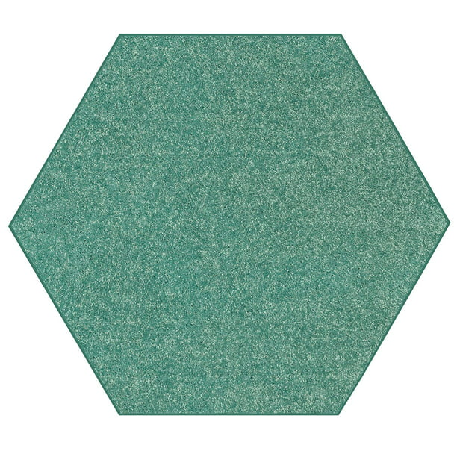
Thank you

